Slide 1


Computer Science I
contact
content
dates
topics
grades
course
August - December 2023
Prepa Tec Campus Eugenio Garza Lagüera

Slide 2
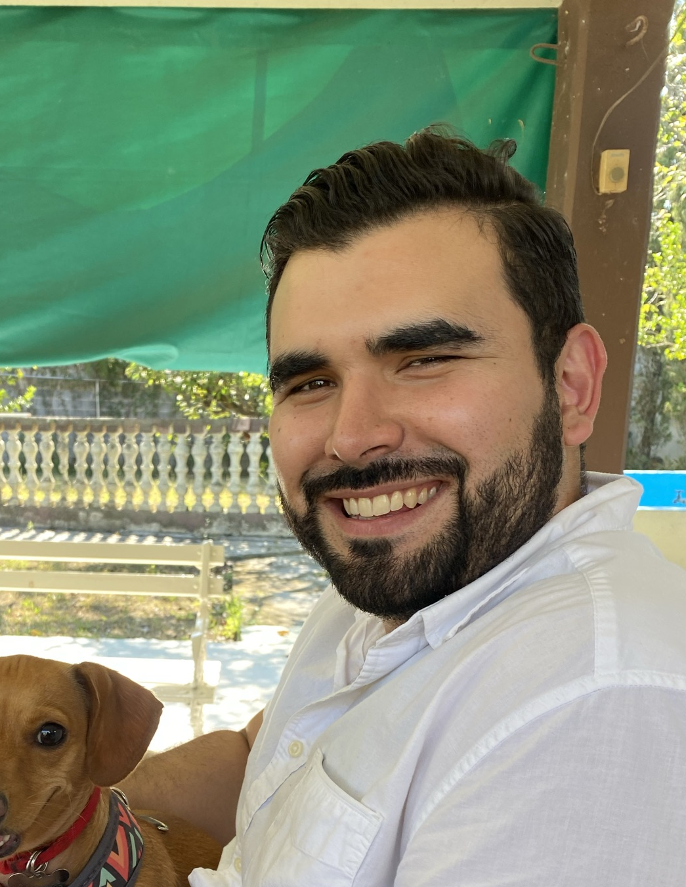








OMAR ACOSTA
omardil@tec.mx
Computer Science
contact
topics
content
dates
grades
course
Notes:
¿Por qué se inscribieron al course?
¿Qué es lo que esperan aprender?
¿Qué les han platicado de la clase?

Slide 3



1
2
3
Understand the digital world
How do the systems and devices with which we interact everyday work?
Logical thinking
How can we solve day to day problems using computers?
Learn to code
How can I build by own programs?
content
contact
dates
topics
grades
course

Slide 4
Monthly grade
Assignments | 30%
Quizzes | 10%
Exams | 50%
Lab | 10%
contact
content
dates
topics
grades
course
Calificación Final
1st Partial | 20%
2nd Partial | 20%
Final Assignment | 20%
Final Exam | 40%

Slide 5
1
2
Computer architecture
Operadores, condiciones y ciclos
1
2
Binary representation
Computational Thinking
contact
topics
content
dates
grades
course
1
Operating Systems and application software
2
3
Introduction to programming
Arrays

Slide 6


Monday, November 21st
1st Partial Exam
Wednesday, September 20th
contact
dates
content
topics
grades
course
2nd Partial Exam
Wednesday, October 25th
Wednesday, November 22nd
Last day of classes
Wednesday, December 5th
Last day of exams

Slide 7





experiencia21.tec.mx/
ID: 975 765 5185
contact
content
dates
topics
grades
course
Schedule tutoring through email
omardil@tec.mx
github.com/OMardil

